Slide 1
Beta Check-in Presentation Switch Alignment Mobile Game
Team Union Pacific
Jiayue Chai
Zack Joyce
Alexa Kelley
Mike Walton
Daniel Wylie
Department of Computer Science and Engineering
Michigan State University
Spring 2023

Slide 2
Project Overview
A game to train Union Pacific employees to identify different switch alignments.
Designed for Android and browser platforms with first-person view and realistic simulations.
Infinite runner style with scoring feature and leaderboard.
Include various challenging conditions such as nighttime and snowy weather.

Slide 3
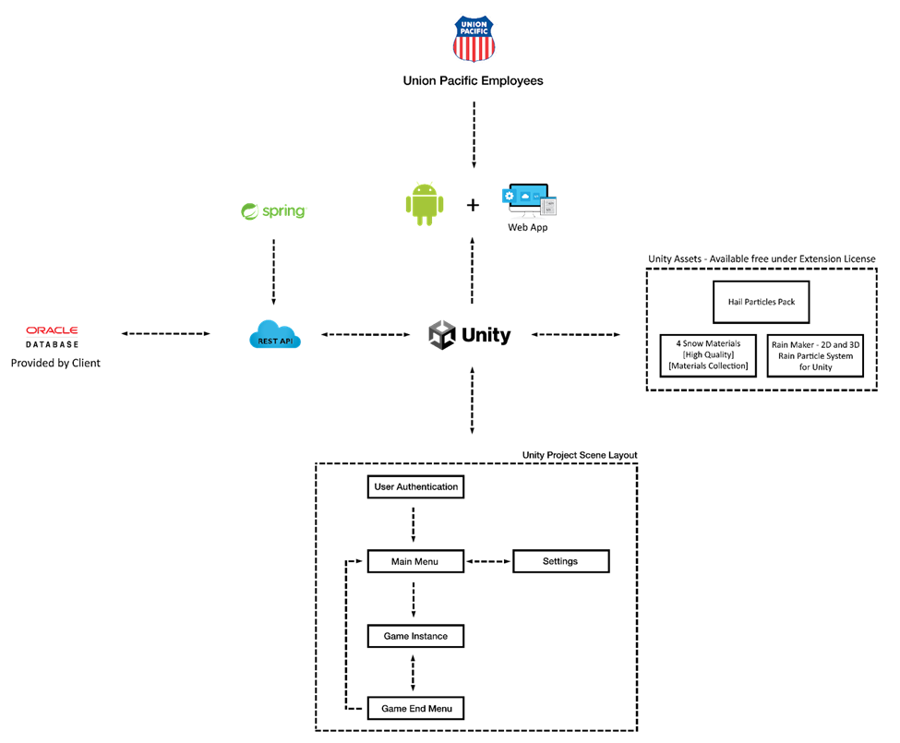
System Architecture

Slide 4
What’s Left Overview
Swipe interaction in the game.
Status: Completed.
Particle system of rain and snow.
Status: Completed.
Leaderboard and scoring.
Status: Completed.
Random weather generation.
Status: Completed.
Sloped terrain.
Status: Not started/may not implement

Slide 5
Live Demo
Skip this slide, use it as a jumping off point for your live demo

Slide 6
Who Has Completed What - Zack
Set up Oracle Database over cloud with local instance on demo computer.
Created REST API in Spring boot and linked it to Tomcat Apache Server with all necessary database calls.
Created leaderboard and login screen with necessary calls in Unity to database.
Added functionality to save score to database and locally.
Created script to move camera along points on track.

Slide 7
Who Has Completed What - Jaiyue
Made main menu, pause, and game over scenes.
Time changing feature.
Snowy tracks.
Random weather (sun, rain, and snow).
Improved movement on tracks.

Slide 8
Who Has Completed What - Mike
Connection from unity game to database.
Service calls.
Created new prefabs for track generation.
Added to script to track generation and camera to allow new generation of switches.

Slide 9
Who Has Completed What - Alexa
Created prefabs for various switches.
Random continuous track generation.
Initial (naive) camera following.
Added decision making system/gameplay.
Added indicator panels.

Slide 10
Who Has Completed What - Daniel
Terrain generation and randomization.
Snowy terrain.
Grassy terrain.
Design day video script.
Design day video music and production initial phase.
Created numerous terrain prefabs.

Slide 11
What’s left to do Before Betas?
Track generation.
Logic for trailing switches.
Sublevel/tunnel.
Sort database by service unit.
Implement random weather/time of day with sublevel system.

Slide 12
Questions?
?
?
?
?
?
?
?
?
?

